Slide 1
SAP Fiori Sharing
S/4 Lab - Fiori Group
2025/03/03

Slide 2
Sharing Topic
SAP Fiori Overview – (Nicole Mo)
SAP Fiori APP Library & Authorization – (Felix Yang)
SAP Fiori App Deployment – (Clyde Liu)
SAP Fiori develop, extend sharing – (Ver Guo)
Notes:
SAP Fiori Overview – (Nicole Mo) – 15~20 min
SAP Fiori APP Library & Authorization – (Felix Yang) – 15~20 min
SAP Fiori App Deployment – (Clyde Liu) – 30 min
SAP Fiori develop, extend sharing – (Ver Guo) – 40 min

Slide 3
SAP Fiori Overview

Slide 4
Agenda
Understand SAP’s UX strategy & Benefits
SAP Fiori Design System
Evolution of SAP Fiori
SAP Fiori vs SAP GUI Transaction
SAP Fiori APP Types
Rapid SAP Fiori Implementation Methodology

Slide 5
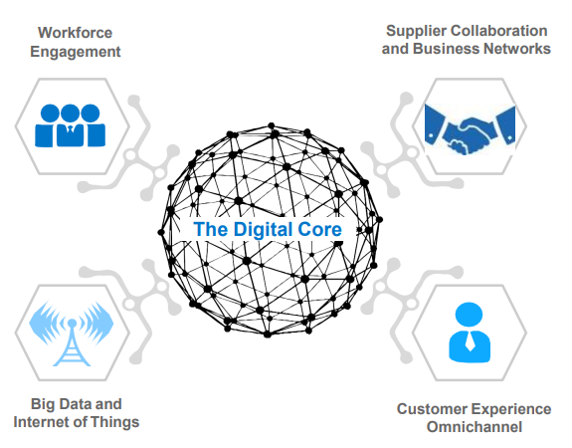
Understand SAP’s UX strategy
- Why SAP Fiori ?
SAP Fiori UI is designed to improve the overall user experience and make enterprise software applications more user-friendly and intuitive.
It is a significant part of SAP's strategy to modernize its software and make it more accessible and user-centric, aligning with the evolving needs and expectations of businesses and their users.

Slide 6
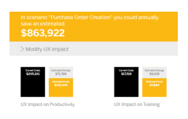
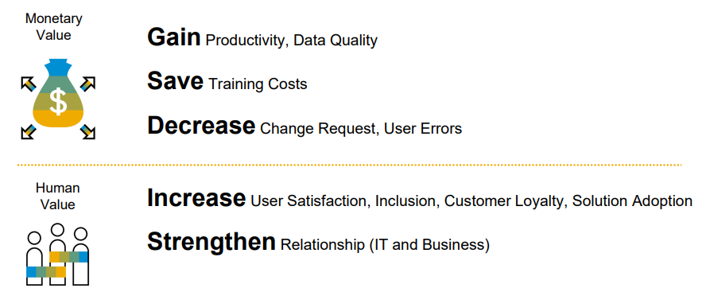
The value of good user experience (UX)
- Why do businesses need Fiori?
UX Value Calculator

Slide 7
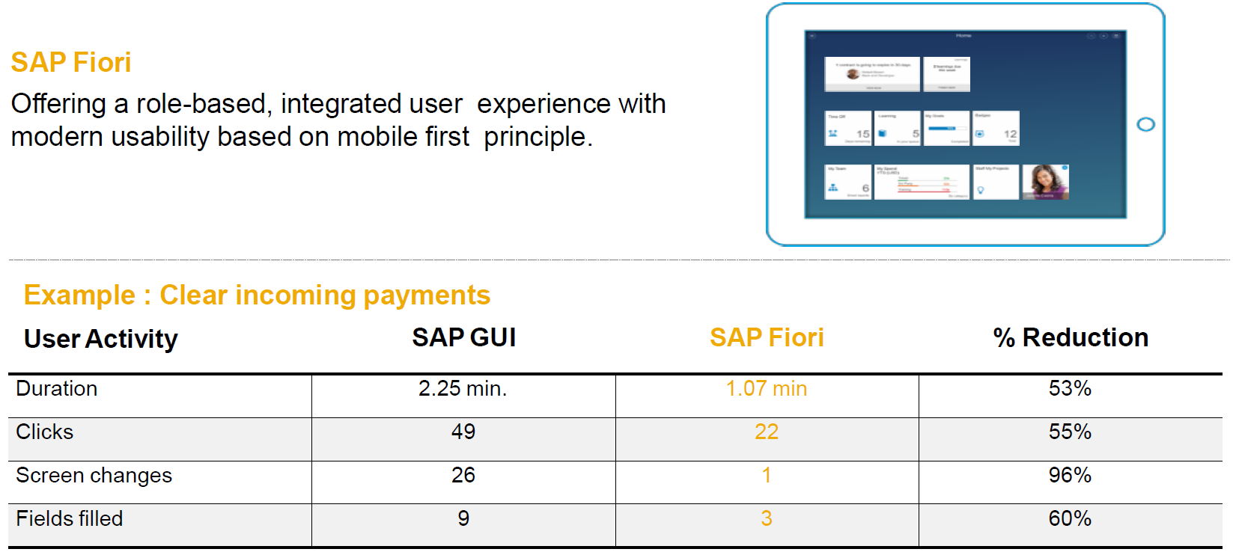
SAP Fiori and SAP S/4HANA User Experience
- Simplified for your needs
Notes:
SAP Fiori通过基于角色的、移动优先的设计原则，提供集成化、且现代易用的用户体验，从而提高用户效率和满意度。

Slide 8
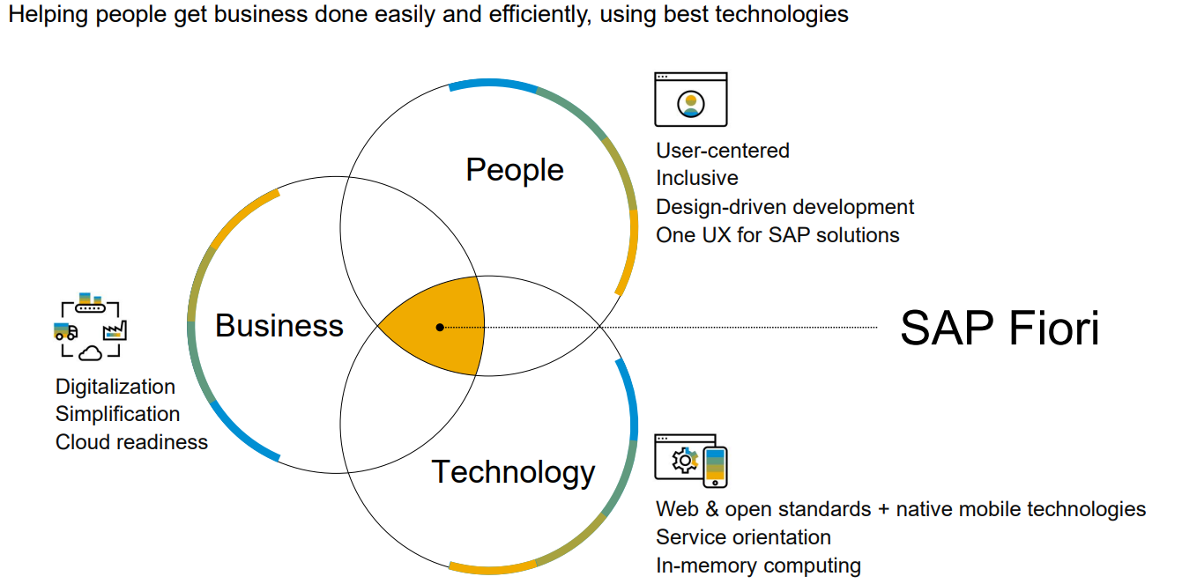
SAP Fiori
Helping people get business done easily and efficiently, using best technologies
Notes:
SAP Fiori的目标： 利用最佳技术帮助人们轻松高效地完成业务。
SAP Fiori通过综合考虑人员、业务和技术，以提供易于使用、高效且集成的业务解决方案。

Slide 9
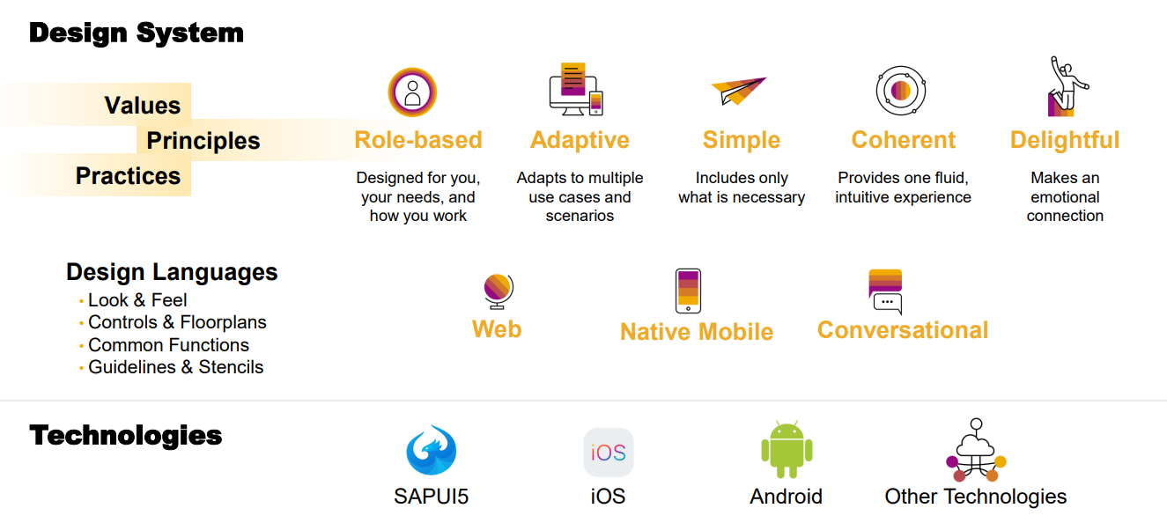
SAP Fiori design system
For many technologies
Notes:
SAP Fiori的设计系统：
- SAP Fiori 通过一系列设计原则、实践和技术，为用户提供一个统一、直观且愉悦的用户体验。

Slide 10
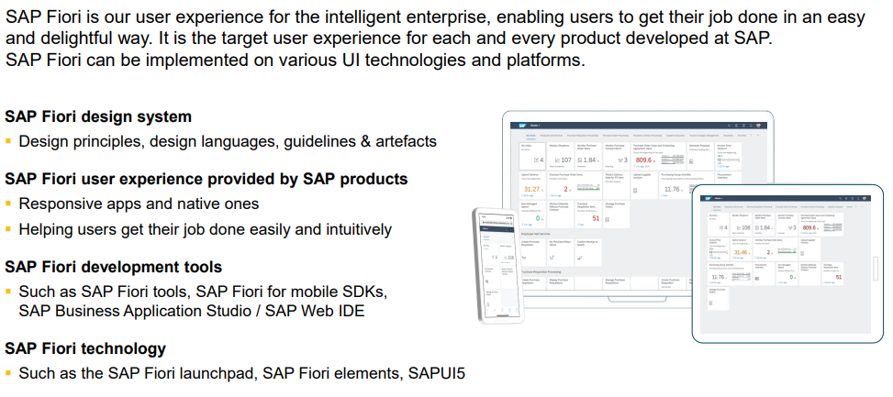
SAP Fiori – in a nutshell

Slide 11
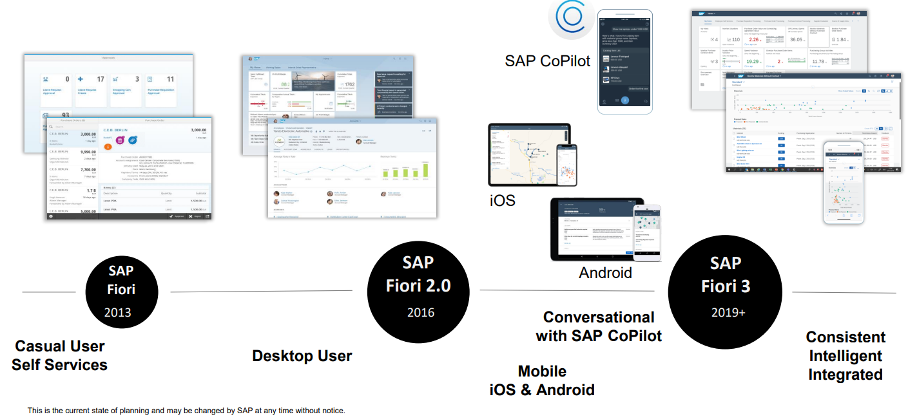
The evolution of SAP Fiori
Notes:
SAP Fiori 的推出旨在重构 SAP GUI，简化操作，并提供移动优先的轻量级应用，自推出以来，Fiori 经过了多次迭代更新：
SAP Fiori (2013)：
首次推出25个“轻量级”事务型应用，引入基于角色的设计理念来优化用户体验。
初始版本专注于为终端用户（Casual User）提供自助服务（Self Services）。
主要针对桌面用户（Desktop User）。
SAP Fiori 2.0 (2016)：
随着移动设备的普及，SAP Fiori 2.0 进一步发展，开始支持移动设备。
这个阶段的Fiori不仅适用于桌面用户，还扩展到了移动用户，支持iOS和Android操作系统，提供了跨平台的用户体验。
SAP Fiori 3 (2019+)：
SAP Fiori 3引入了与SAP CoPilot集成的对话式界面， 提供一致且智能的用户体验
（這次更新的一個主要目標是讓所有SAP產品都能用上統一的設計，這樣用戶在用不同的SAP產品時會感到很熟悉、很一致Fiori ）
SAP Fiori与SAP CoPilot的集成，提供更智能的交互方式，如语音和自然语言处理能力。
SAP CoPilot 是SAP推出的一款AI助手，它能够理解自然语言并执行任务，使得用户能够更自然地与SAP Fiori应用程序互动。

Slide 12
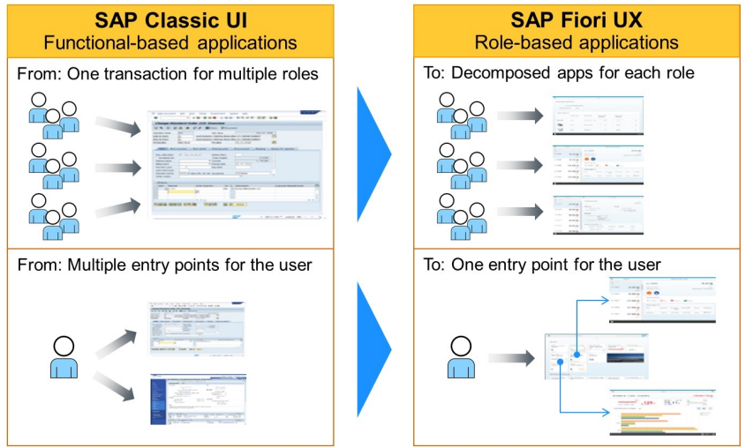
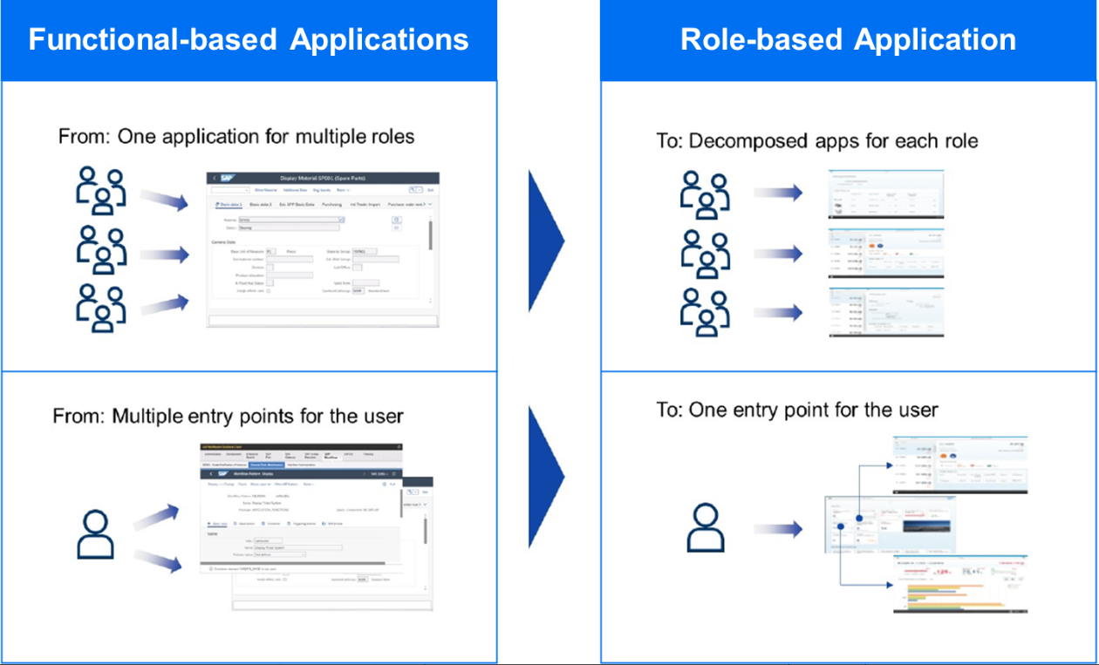
- Fiori : Role-Based User Experience
SAP Fiori vs SAP GUI Transaction
Role-Based Access Principle:
Purpose: Enhances user interaction relevance and efficiency.
Method: Tailors experiences to specific roles within an organization.
Outcome: Provides a personalized, task-oriented experience aligned with each user's responsibilities and permissions.

Slide 13
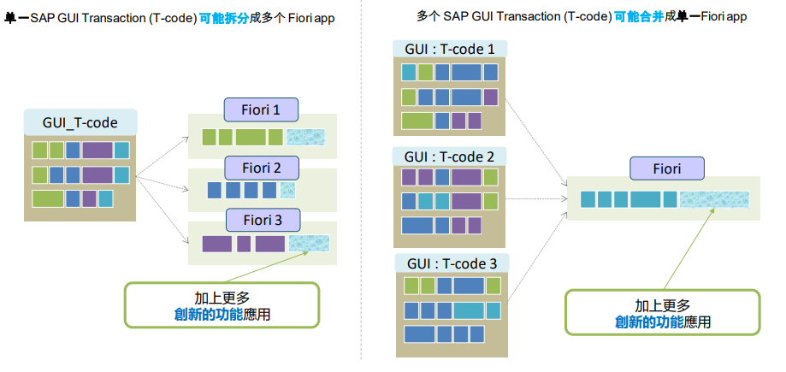
SAP Fiori vs SAP GUI Transaction

Slide 14
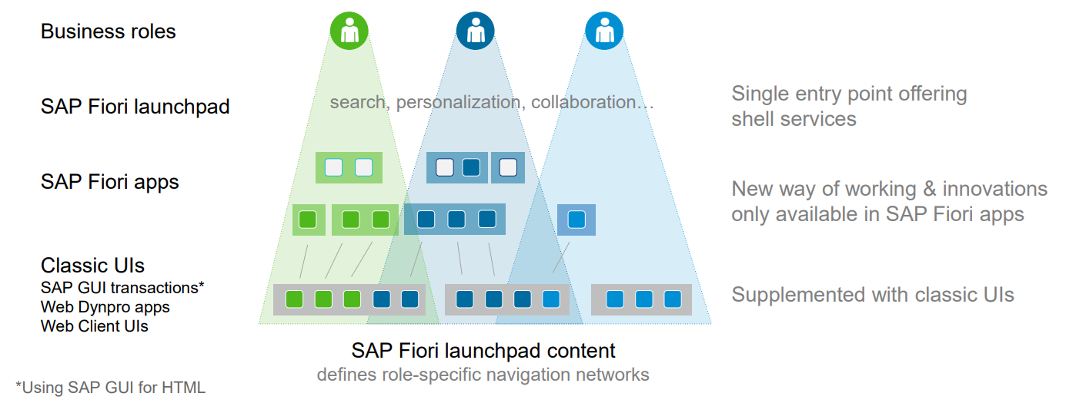
How to Get SAP Fiori Up and Running
SAP Fiori offers a new way of working with SAP S/4HANA
The transition to SAP Fiori for SAP S/4HANA focuses on providing innovative user interactions instead of like-for-like replacement of traditional transactions through SAP Fiori applications

Slide 15
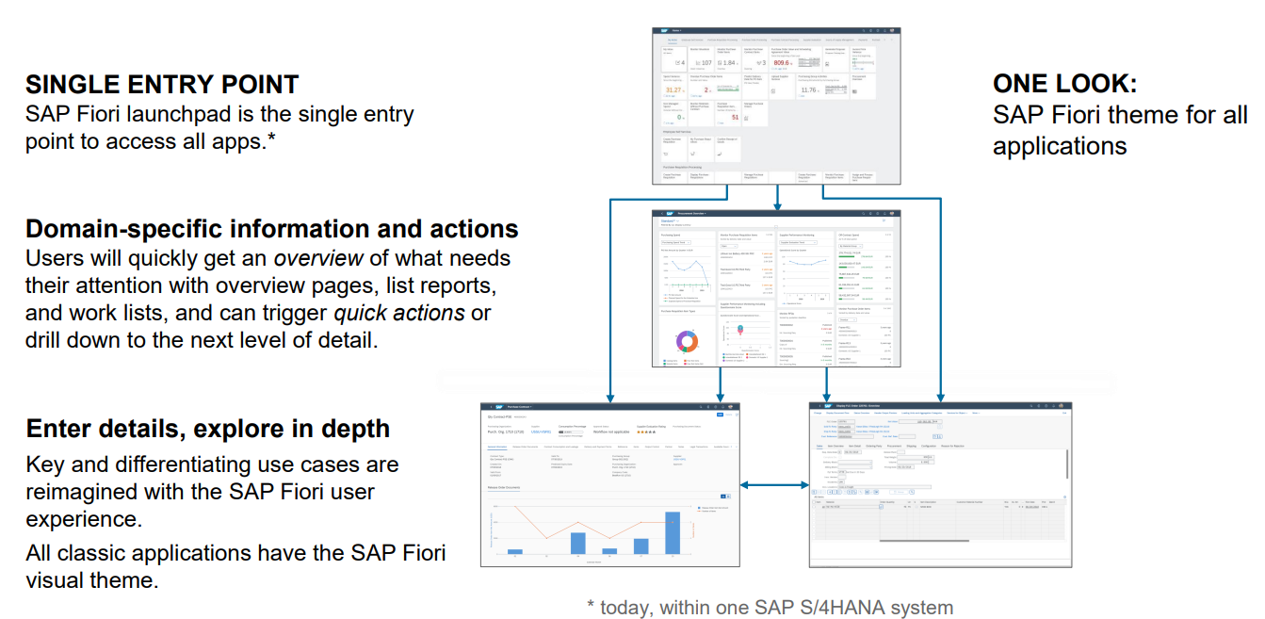
SAP Fiori: the user experience of SAP S/4HANA
Notes:
SAP Fiori提供了 ”统一外观”（One Look），意味着所有应用程序都采用了统一的SAP Fiori主题，确保了应用程序间的一致性。
SAP Fiori Launchpad 作为 访问所有应用程序的单一入口点，简化了用户访问流程；
用户可以通过overview 、list report & work list快速获得需要关注的信息，并能够触发快速操作或深入到下一层细节。

Slide 16
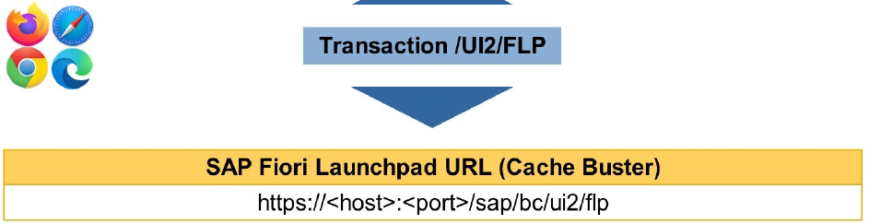
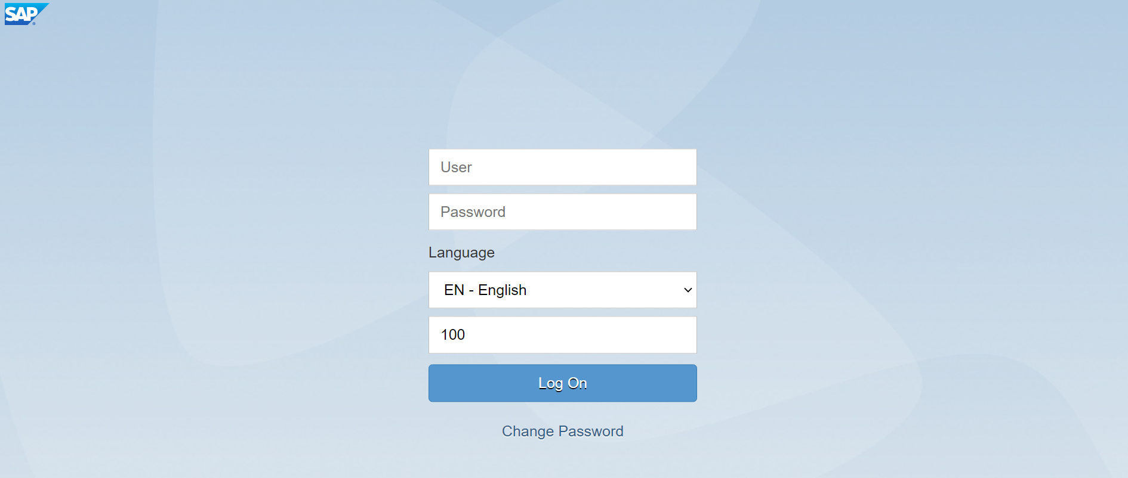
SAP Fiori Launchpad Using a Web Browser
SAP System | Fiori URL
DEV | https://saps4dev.wistron.com:44300/sap/bc/ui2/flp
QAS | https://saps4qas.wistron.com:44300/sap/bc/ui2/flp
PRD | https://vhwscwp1wp2lb.sap.wistron.com:44300/sap/bc/ui2/flp

Slide 17
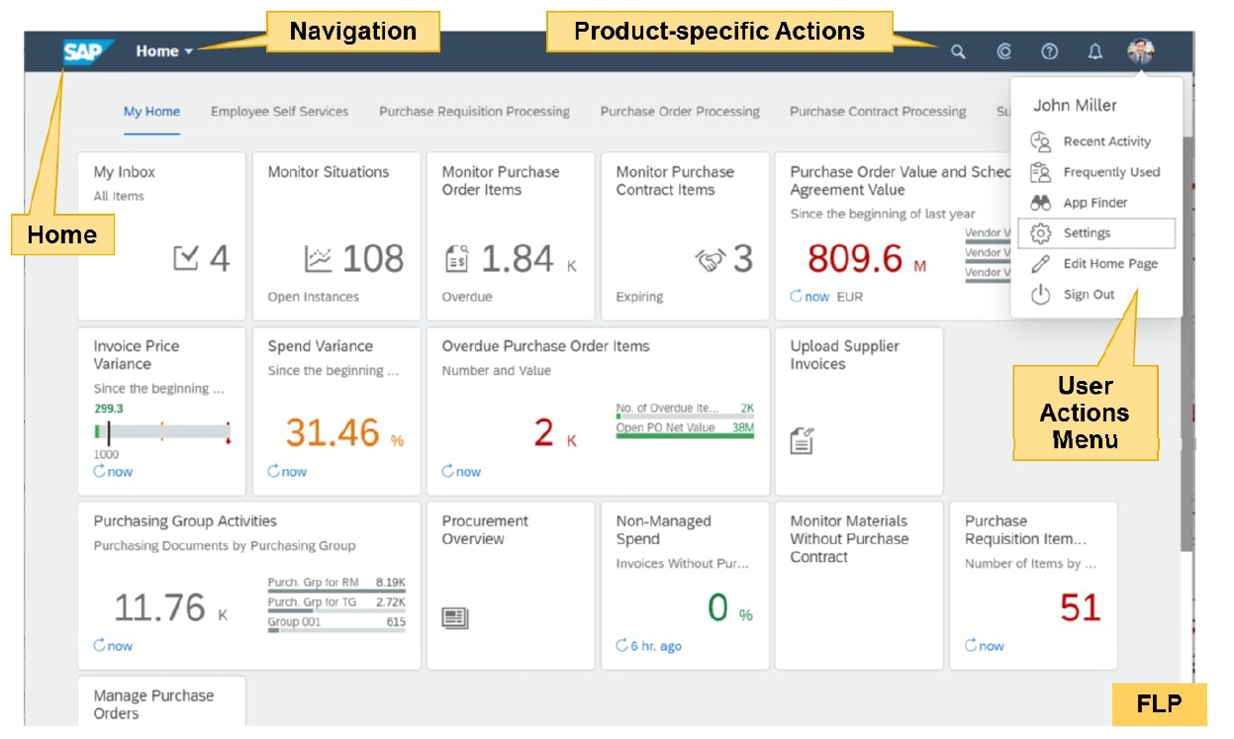
SAP Fiori 3 Home Page
Static Tiles : Displays the title and icon in Fiori tile
Dynamic Tiles : Displays the title, icon and count
KPI Tiles : Displays the title, icon and count as micro-charts, graphs and analytic details
Dynamic tiles
KPI tiles
Static tiles

Slide 18
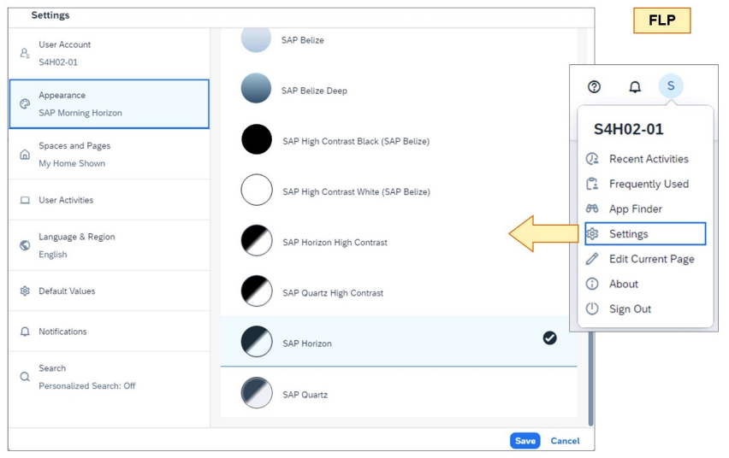
Personalizing SAP Fiori
End users can personalize their own variant of the SAP Fiori launchpad (FLP). The settings can be accessed via the User Actions Menu.

Slide 19
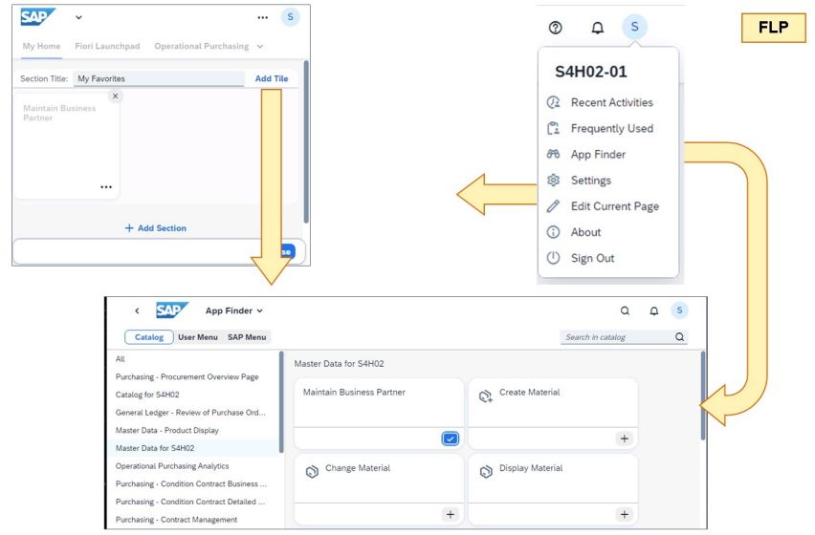
Personalizing SAP Fiori
End users can personalize their home page SAP Fiori launchpad (FLP). The settings can be accessed via the User Actions Menu.

Slide 20
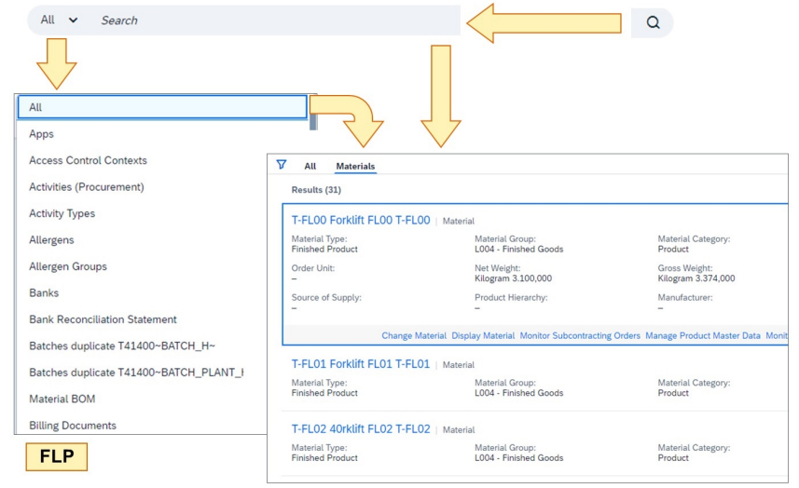
SAP Fiori Search
SAP Fiori offers a powerful search to find contents in the SAP Fiori launchpad (FLP). Using any database, you can search for text fragments of SAP Fiori tiles. However, when using SAP HANA, all business data of the back-end server (BES) can be searched quickly.
To access the SAP Fiori search, open the Search field at the top of the FLP, select a data area, and enter any value of a dataset in the BES. You may use the wildcard * as a placeholder.

Slide 21
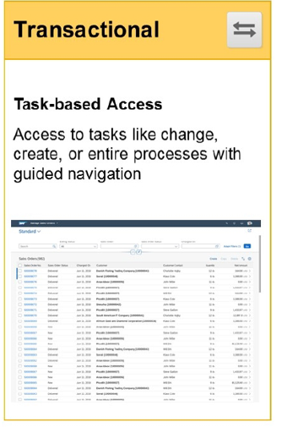
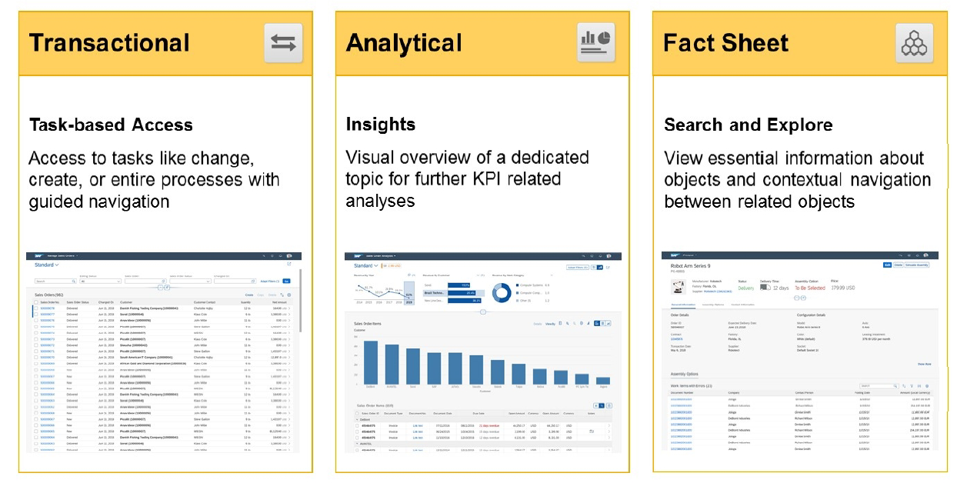


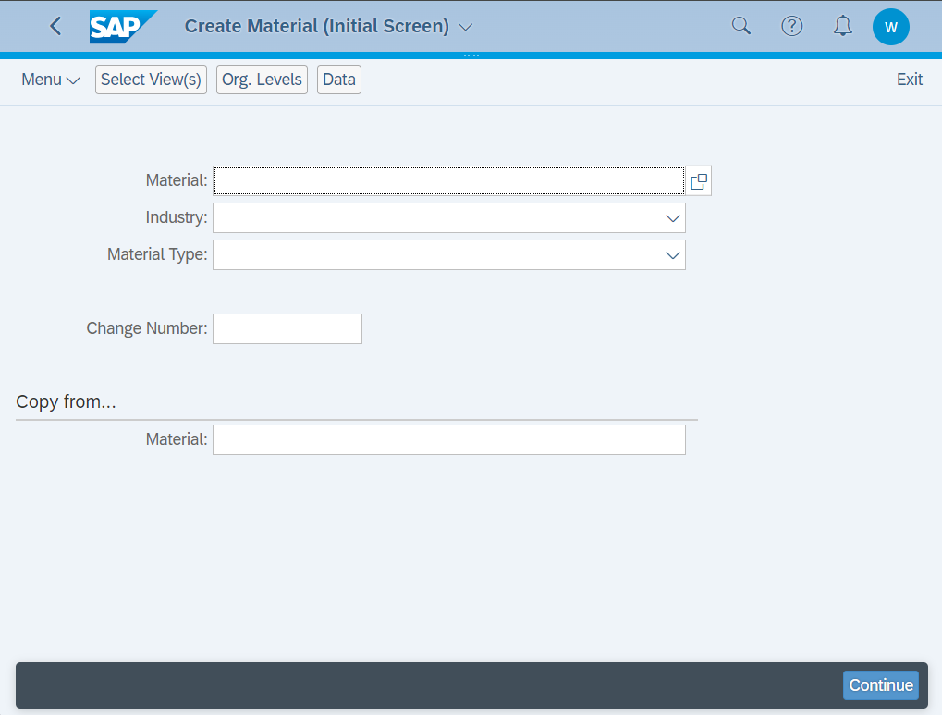
SAP Fiori APP Types (S/4 HANA 2021)
SAP GUI
SAP GUI

Slide 22
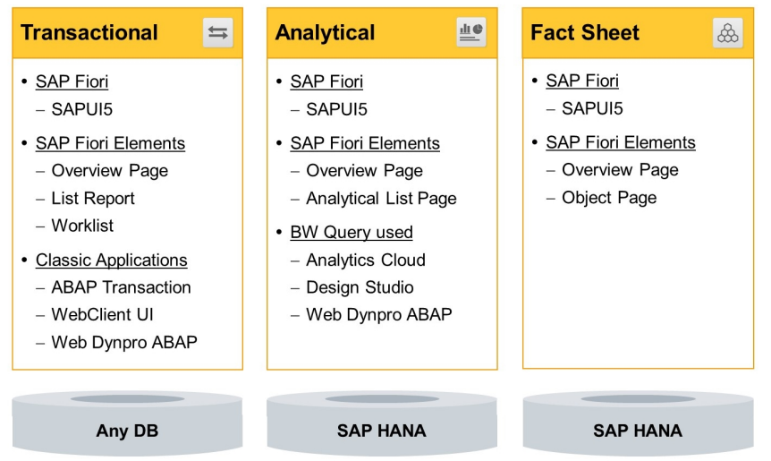
SAP Fiori APP Types (S/4 HANA 2021)
The three types of SAP Fiori apps are different in terms of their usage of additional technologies

Slide 23
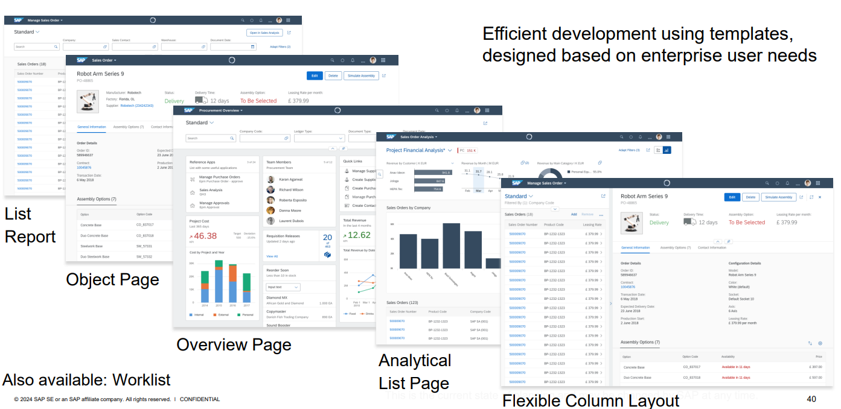
SAP Fiori elements
Notes:
Fiori Elements 框架提供了多种模板类型，涵盖了不同类型的应用需求。
List Report 模板用于显示数据列表和过滤功能，
Object Page 模板用于显示单个数据对象的详细信息，
Analytical List Page 模板则用于展示复杂的分析数据。
Fiori Elements 与 SAP 后端服务的集成非常容易。
通过定义正确的 OData 服务，Fiori Elements 可以直接与后端数据通信，并生成与数据相关的用户界面.

Slide 24
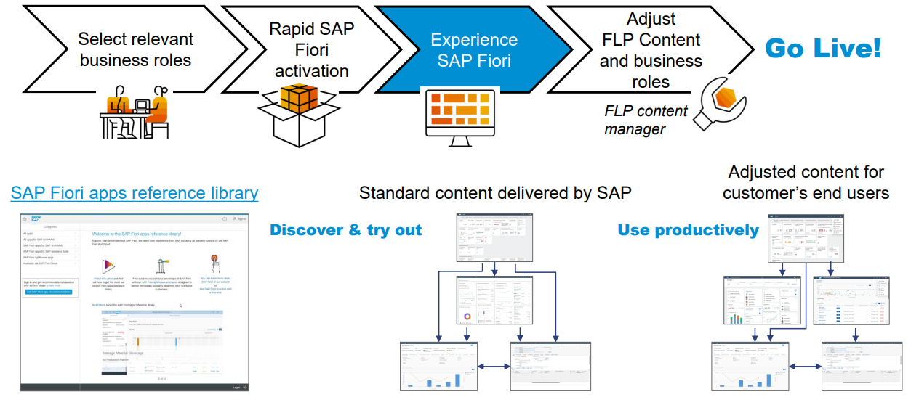
体验SAP Fiori for SAP S/4HANA开箱即用，快速上线
FLP = SAP Fiori launchpad
确定范围
调整与扩展
(确定所涉及的业务角色)
按照角色快速激活
(按需调整展示页面的内容与布局)
SAP Fiori apps reference library
SAP Rapid Activation
Launchpad Content Manager
Notes:
SAP Fiori应用程序库提供了大量预构建的应用程序 (到目前为止有上万个APP :16694)，覆盖了各种业务功能。用户可以根据自己的业务需求选择和激活这些应用程序。

Slide 25
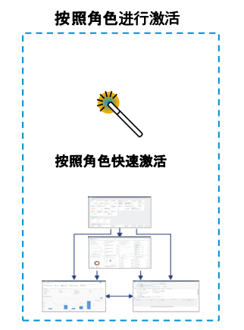
Rapid Activation帮助您按照角色批量激活SAP Fiori Apps
Rapid Activation使按照角色激活SAP Fiori Apps成为可能，可以最大限度的缩短激活SAP Fiori Apps的时间：
SAP Fiori for SAP S/4HANA – Activate SAP Fiori in 1 day or less – the video playlist and FAQ
Rapid Activation of SAP Fiori in SAP Help Portal
SAP Note 2902673 - Rapid Activation for SAP Fiori in SAP S/4HANA – Overview

Slide 26
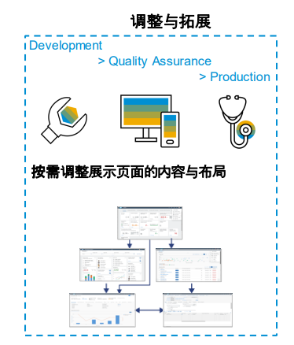

调整SAP Fiori更贴合您的需求
在按照角色批量激活SAP Fiori Apps之后，需要作进一步的个性化调整。
如何创建您特定的业务角色： SAP Fiori for SAP S/4HANA – Creating your custom business roles – the end-to-end process and video playlist
工具介绍：SAP Fiori for SAP S/4HANA – Overview of tools for maintaining custom launchpad content and layout
Launchpad App Manager
Launchpad Content Manager
SAP Fiori Content Activation task list
Manage Launchpad Spaces / Pages

Slide 27
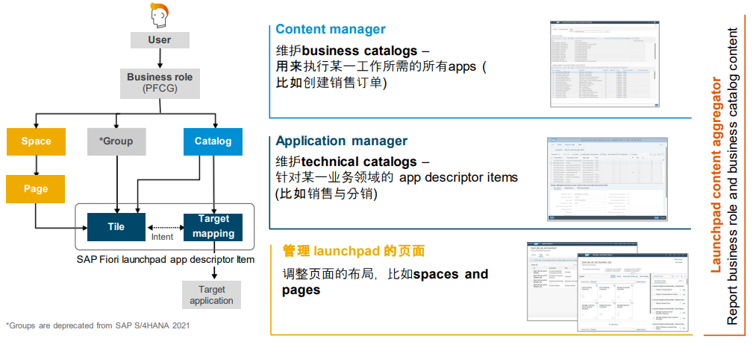
调整SAP Fiori Launchpad内容与布局的工具
更多信息：
SAP Fiori for SAP S/4HANA – Creating your custom business roles – the end-to-end process and video playlist

Slide 28
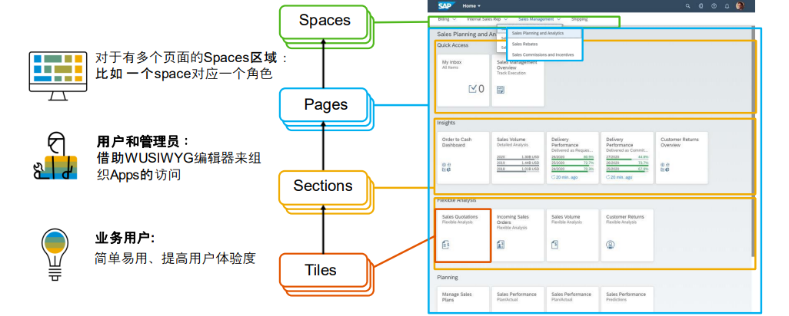
通过Spaces和Pages优化 SAP Fiori launchpad 布局 (从SAP S/4HANA 2020版本开始)
视频: What are SAP Fiori Launchpad Spaces
更多信息：
Recommendation for Structuring Roles, Spaces and Pages in the SAP Fiori Launchpad Based on Common User Behaviors
Notes:
WUSIWYG

Slide 29
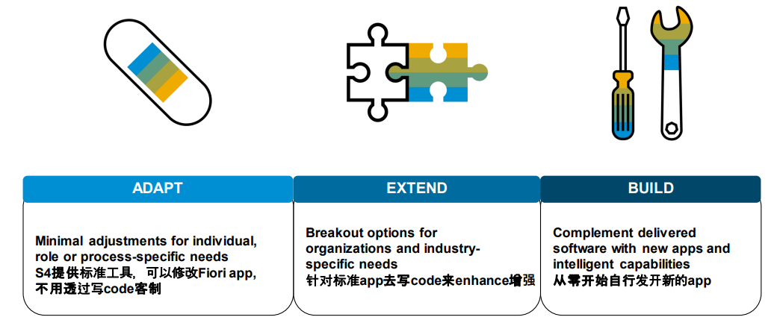
针对Fiori中无法满足的需求
Adapt, extend or build?
更多信息：
SAP S/4HANA Extensibility:A Learning Journey

Slide 30
Wistron S/4 Lab - 個性化用戶體驗 Fiori工作台成果

Slide 31
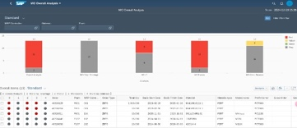
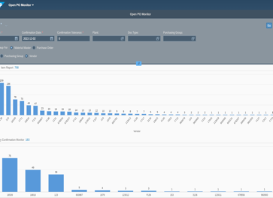
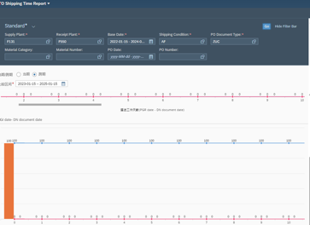
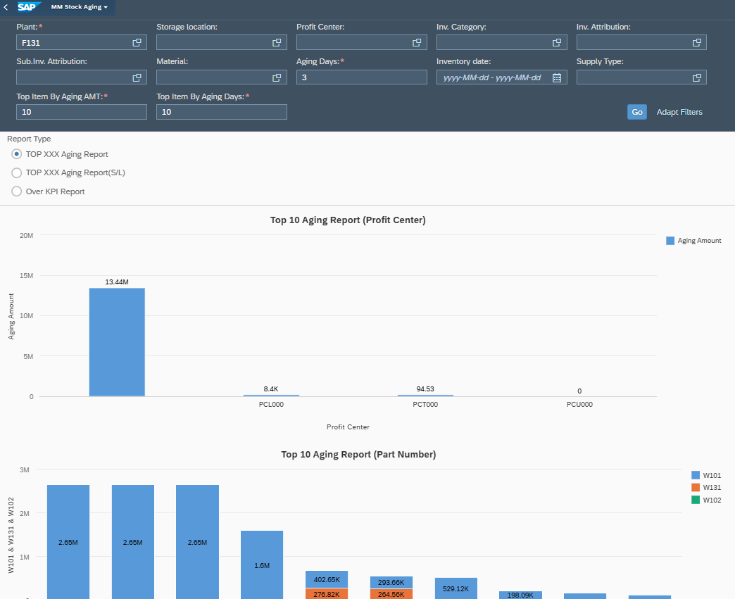
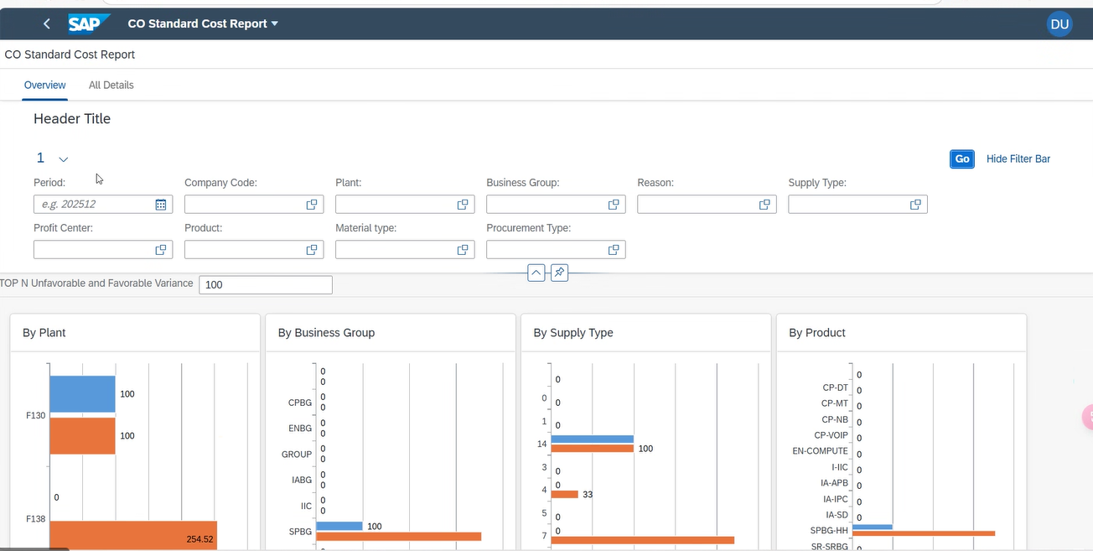
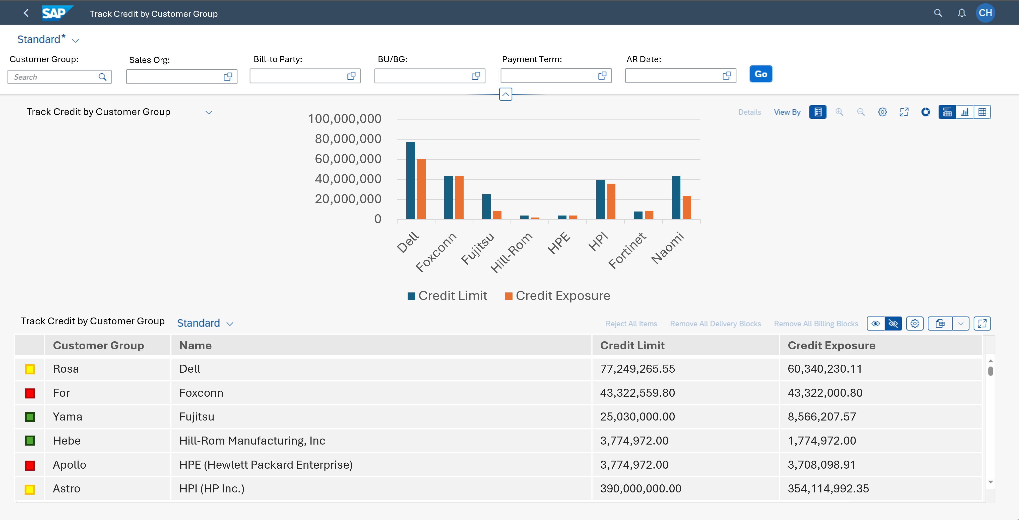

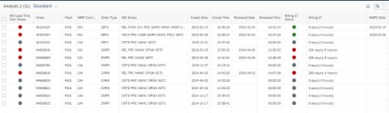
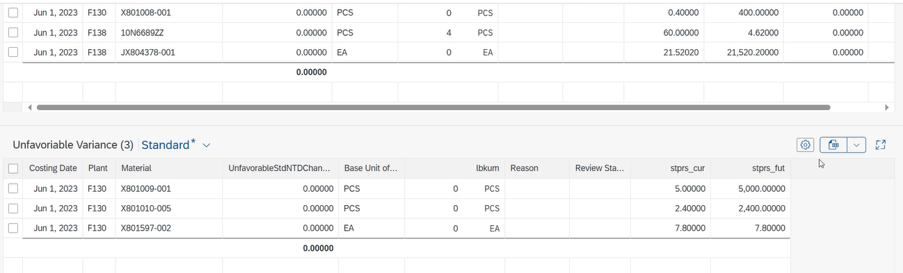
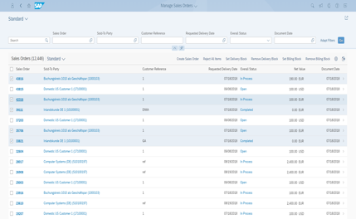
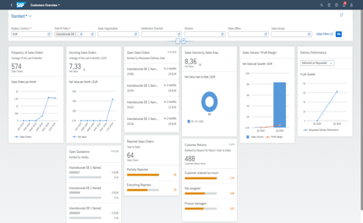
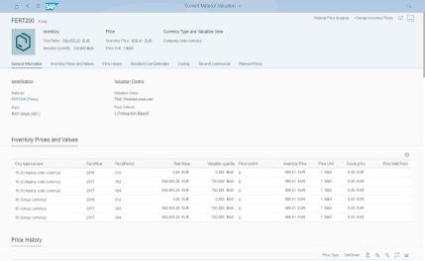
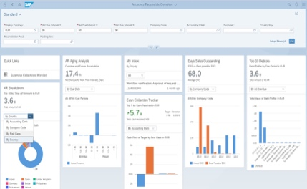

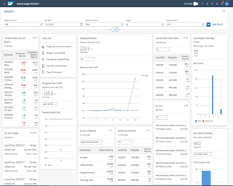
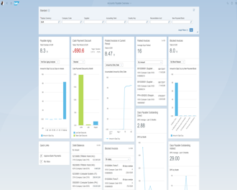
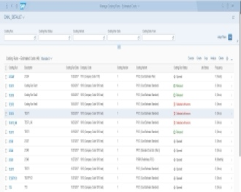
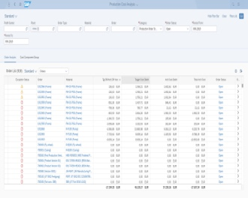
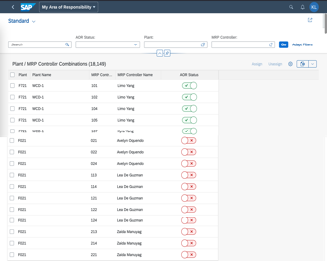

以標準 Fiori APP為起點，全方位面打造不同業務場景的應用
App類型
成果
效益
6
客制 App (Workbench)
Dedicated
一站式管理 (工作臺)
MO
Analysis
Open PO Monitor
STO shipping Time Report
CO Standard Cost Report
Credit Management Track
全流程
即時性
Stock Aging
4
延伸 App (Extension)
Advanced
彈性調配
Manage
Sales Orders
Customers
Overview
Manage
Material Valuations
AR
Overview
效率
延展性
5
標準 App (Standard)
Basic
開箱即用
GL
Overview
AP
Overview
Estimated
Costs
Production Cost
Analysis
Area of Responsibility MRP Controller
效率
成本
參考
Notes:
Std. Extension
SD:
- Manage Sales Order (F1873)
- Customers Overview (F4645)
FI: Accounts Receivable Overview(F2917) -- 只需要开发ABAP GUI端程序
CO: Manage Material Valuations(F2680)
Std :
F2445 : General Ledger Overview
F2917 : Account Payable Overview
F3242 : Account Receivable Overview
F2680 : Manage Material Valuations
F1780 : Production Cost Analysis
F1865 : Manage Costing Runs - Estimated Costs

Slide 32
Thank You!

